Slide 1
Micro-Credit Defaulter Model
Smita More

Slide 2
Introduction
A Microfinance Institution (MFI) is an organization that offers financial services to low income populations. MFS becomes very useful when targeting especially the unbanked poor families living in remote areas with not much sources of income. The Microfinance services (MFS) provided by MFI are Group Loans, Agricultural Loans, Individual Business Loans and so on.
Many microfinance institutions (MFI), experts and donors are supporting the idea of using mobile financial services (MFS) which they feel are more convenient and efficient, and cost saving, than the traditional high-touch model used since long for the purpose of delivering microfinance services. Though, the MFI industry is primarily focusing on low income families and are very useful in such areas, the implementation of MFS has been uneven with both significant challenges and successes.

Slide 3
Now a days telecom industries launched various products and have developed its business and organization based on the budget operator model, offering better products at Lower Prices to all value conscious customers through a strategy of disruptive innovation that focuses on the subscriber.
They understand the importance of communication and how it affects a person’s life, thus focusing on providing their services and products to low income families and poor customers that can help them in the need of hour. They are collaborating with an MFI to provide micro-credit on mobile balances to be paid back in some days e.g. in 5/10/15 days.

Slide 4
Problem Statement
They are collaborating with an MFI to provide micro-credit on mobile balances to be paid back in 5 days. The Consumer is believed to be defaulter if he deviates from the path of paying back the loaned amount within the time duration of 5 days. For the loan amount of 5 (in Indonesian Rupiah), payback amount should be 6 (in Indonesian Rupiah), while, for the loan amount of 10 (in Indonesian Rupiah), the payback amount should be 12 (in Indonesian Rupiah).
The sample data is provided to us from our client database. It is hereby given to you for this exercise. In order to improve the selection of customers for the credit, the client wants some predictions that could help them in further investment and improvement in selection of customers.
Build a model which can be used to predict in terms of a probability for each loan transaction, whether the customer will be paying back the loaned amount within 5 days of insurance of loan. In this case, Label ‘1’ indicates that the loan has been payed i.e. Non- defaulter, while, Label ‘0’ indicates that the loan has not been payed i.e. defaulter.

Slide 5
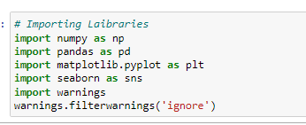
Importing Libraries

Slide 6
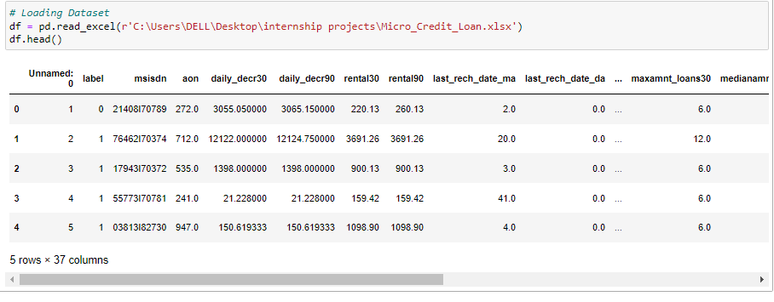
Loading Dataset

Slide 7
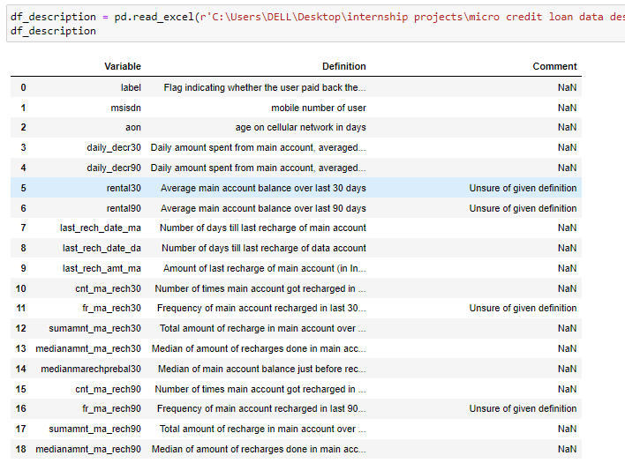
Data Description

Slide 8
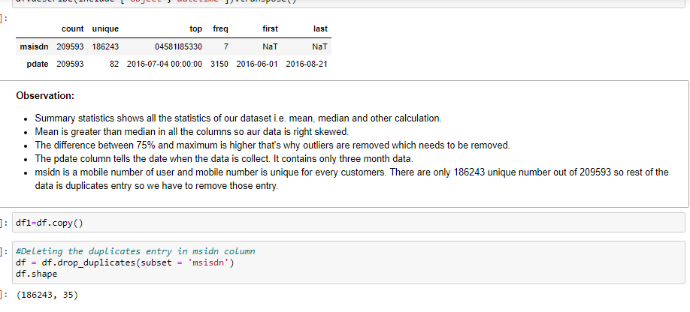
Dropping the duplicate entries

Slide 9
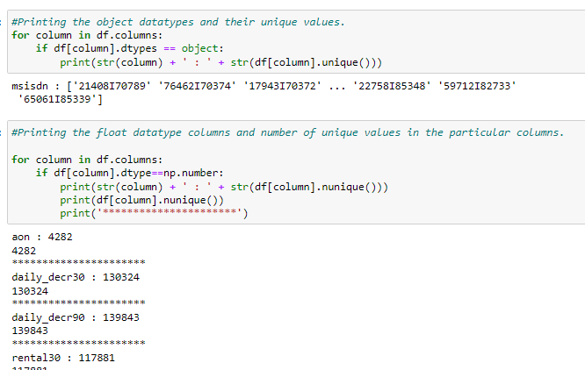
Data Exploration

Slide 10
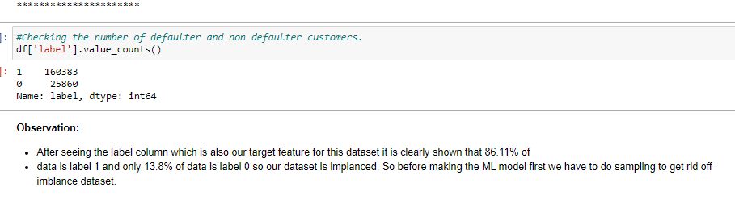
Checking defaulter and non-defaulter customers

Slide 11
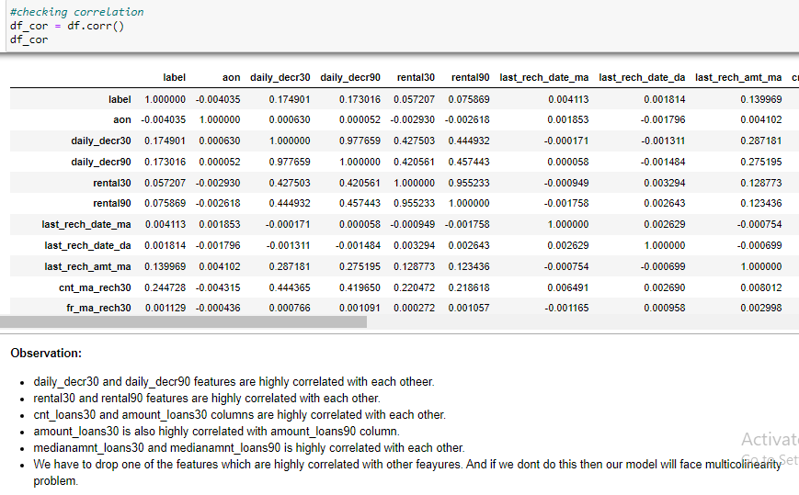
Correlation

Slide 12
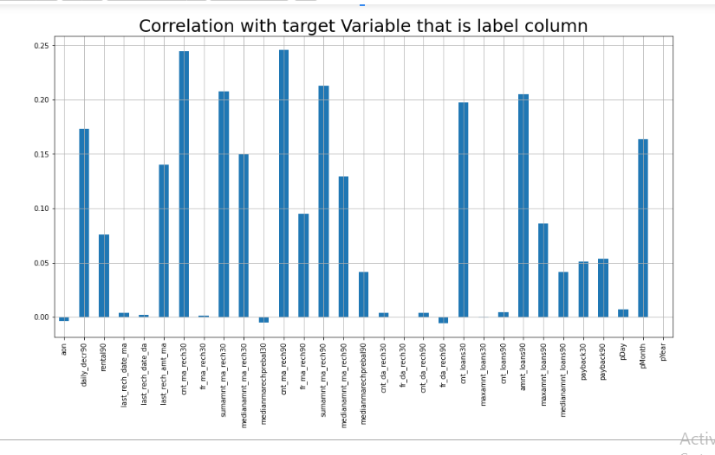
Data Visualization

Slide 13
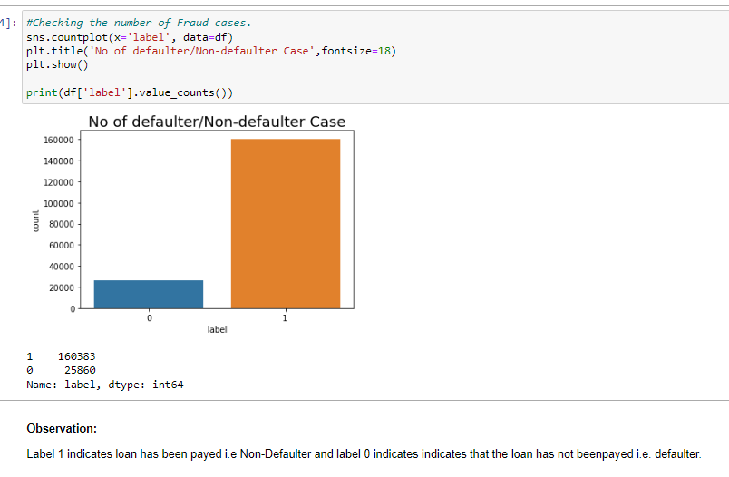

Slide 14
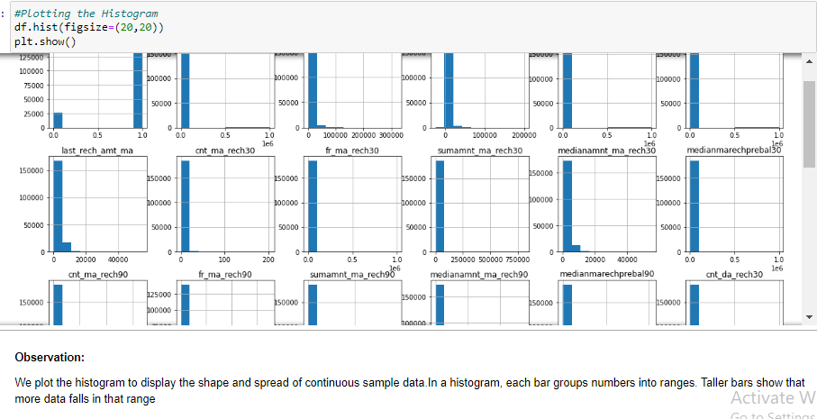

Slide 15
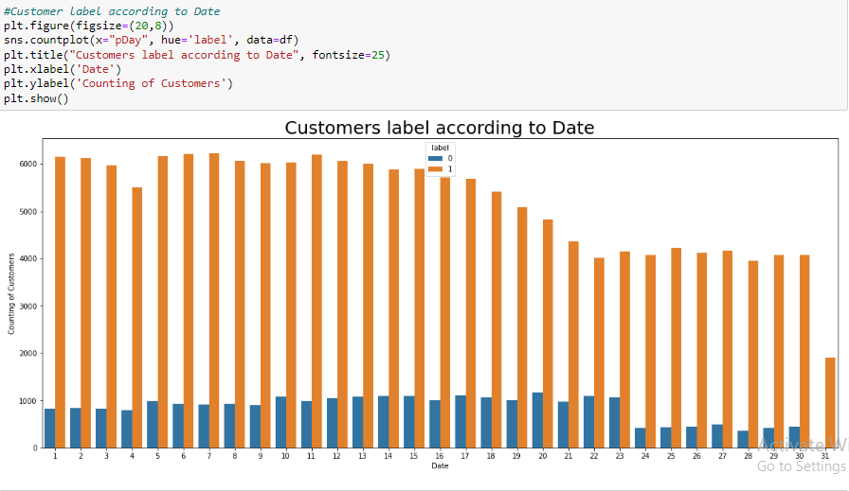

Slide 16
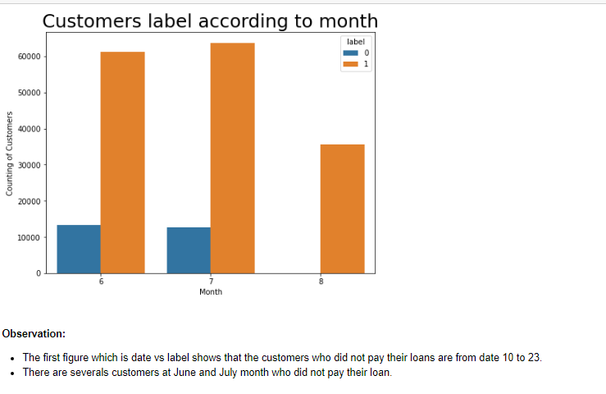

Slide 17
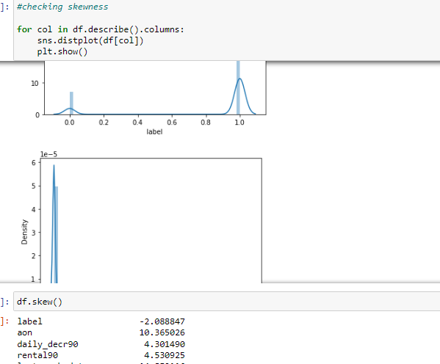
Checking Skewness

Slide 18
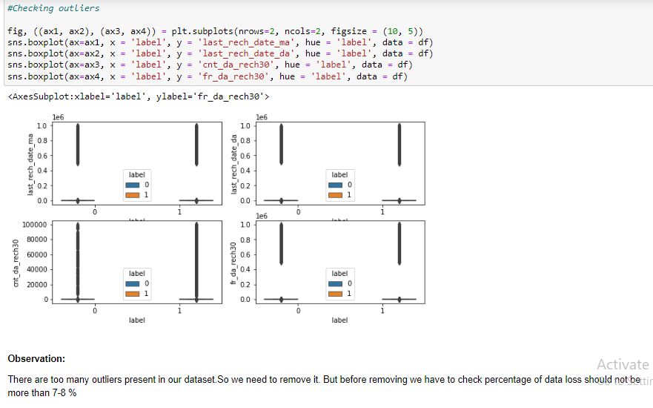
Checking Outliers

Slide 19
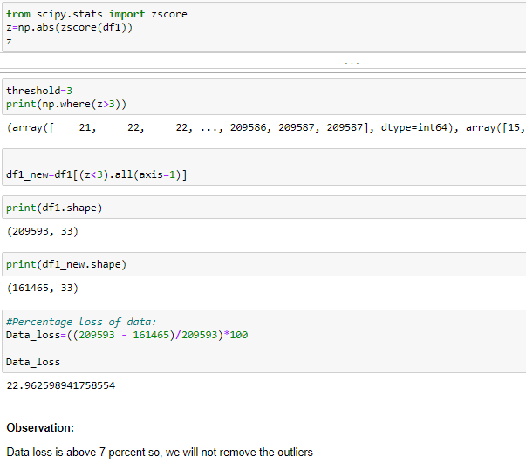
Percentage of Data Loss

Slide 20
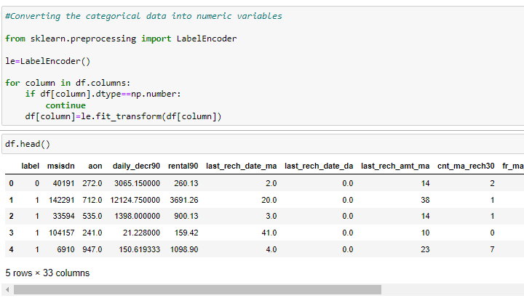
Data Encoding

Slide 21
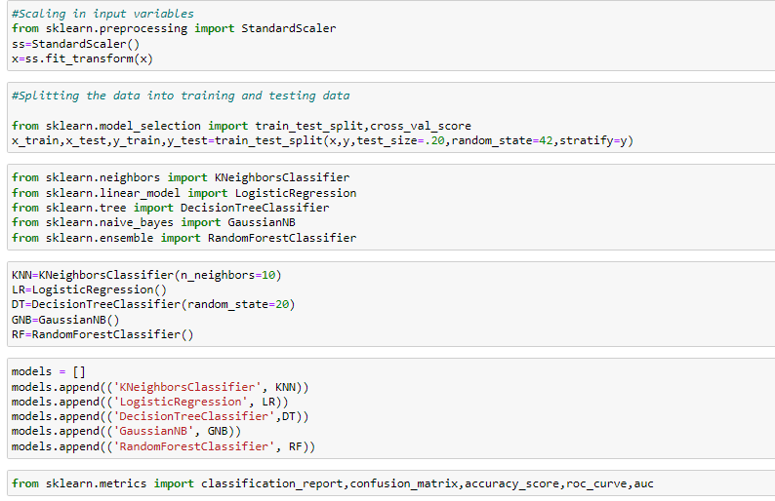
Model Building

Slide 22
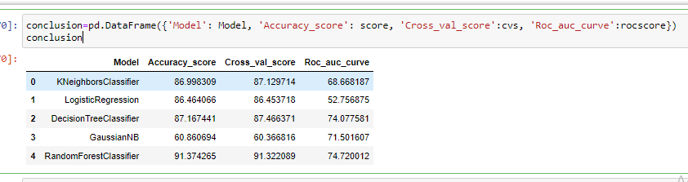
Conclusion

